Slide 1
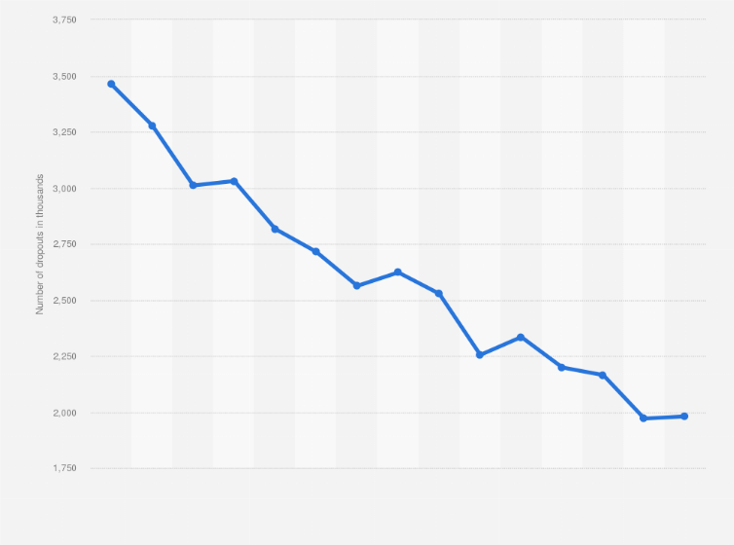
Predict students' dropout and academic success.
Group Members: Abhinanditha Thamada, Kanishka Angirish, Tayler Smith, Trishainah Varnado.
Course: I-501 Introduction to Informatics.
Prof. Zeyana Hamid.
INDIANA UNIVERSITY PURDUE UNIVERSITY INDIANAPOLIS
athamada@iu.edu
kangiris@iu.edu
tbs1@iu.edu
trivarna@iu.edu
Notes:
Add instructor and course

Slide 2



Introduction:
Background:
As the landscape of higher education evolves, there is a growing need to understand the factors that contribute to student success and dropout rates.
Predictive analysis offers a strategic approach to identify potential challenges, ultimately aiming to enhance both retention rates and overall academic achievement.
Our project delves into the application of machine learning models to predict student dropout and academic success using a comprehensive dataset from a higher education institution.
The dataset encompasses a diverse range of student characteristics, including academic path, demographics, social-economic factors, courses, and academic performance indicators. (Martins et al., 2021)
Notes:
Reduce introduction

Slide 3

Aim: Establish the factors that are correlated with withdrawal of studies in higher education.
Hypothesis:
We are able to predict student dropout with predictors
Purpose:
The study endeavors to attain a profound understanding of the intricate interrelationships among various student attributes and their influence on the likelihood of dropout or academic success.
Applying advanced machine learning, the study aims to discern patterns and correlations in the dataset to construct predictive models for individual student outcomes.

Slide 4

METHODOLOGY:
STEPS IN THE PROJECT:
1.Data Collection: https://www.kaggle.com/datasets/shariful07/student-mental-health
2. Data Storage
3. Handle Missing Values
4. Statistical Testing
5. Feature Engineering
6. Model Building
7. Model Performance Evaluation
8. Comparison of Machine Learning Models
9. Results
Notes:
Fix the numbering

Slide 5
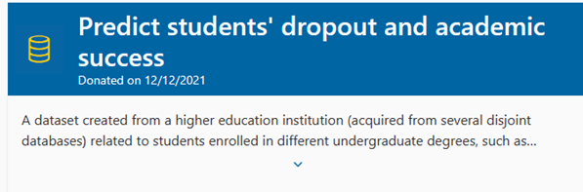
DATA COLLECTION
Source: UC Irvine Machine Learning Repository
Instances : 4424
Columns: 36 variables

Slide 6
DESCRIPTION OF DATASET VARIABLES
VARIABLES | TYPE | VARIABLES
Marital Status Application mode Daytime/evening attendance Previous qualification Nationality Mother's qualification Father's qualification Mother's occupation Father's occupation | CATEGORICAL | Displaced Educational special needs Debtor Tuition fees up to date Gender Scholarship holder Age at enrollment International Target
Application order Course Curricular units 1st sem (credited) Curricular units 1st sem (enrolled) Curricular units 1st sem (evaluations) Curricular units 1st sem (approved) Curricular units 1st sem (grade) | INTEGER | Curricular units 1st sem (without evaluations) Curricular units 2nd sem (credited) Curricular units 2nd sem (enrolled) Curricular units 2nd sem (evaluations) Curricular units 2nd sem (approved) Curricular units 2nd sem (grade) Curricular units 2nd sem (without evaluations)
Previous qualification (grade) Admission grade | CONTINUOUS | Unemployment rate Inflation rate GDP
Notes:
Bullet Point the variables

Slide 7
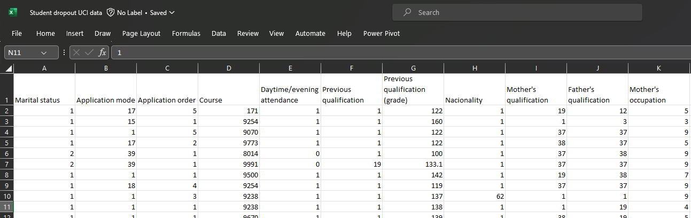

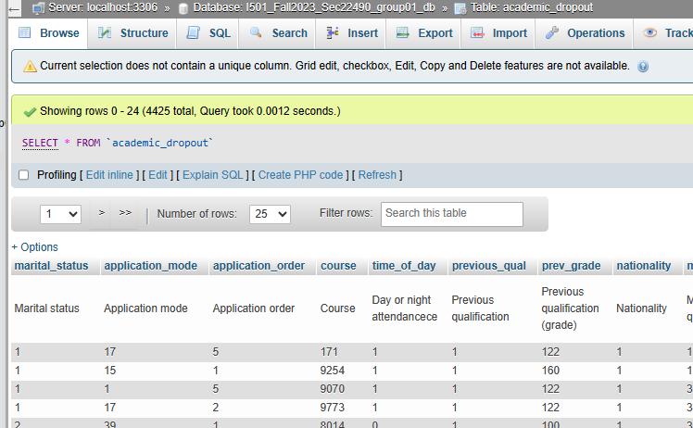
DATA EXTRACTION
Loading data into SQL database hosted by phpAdmin
Downloaded data from UCI MLR as .csv
Removed GDP variable due to improper formatting
Successfully uploaded 35 variables to the shared SQL database

Slide 8
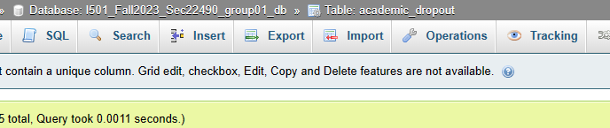
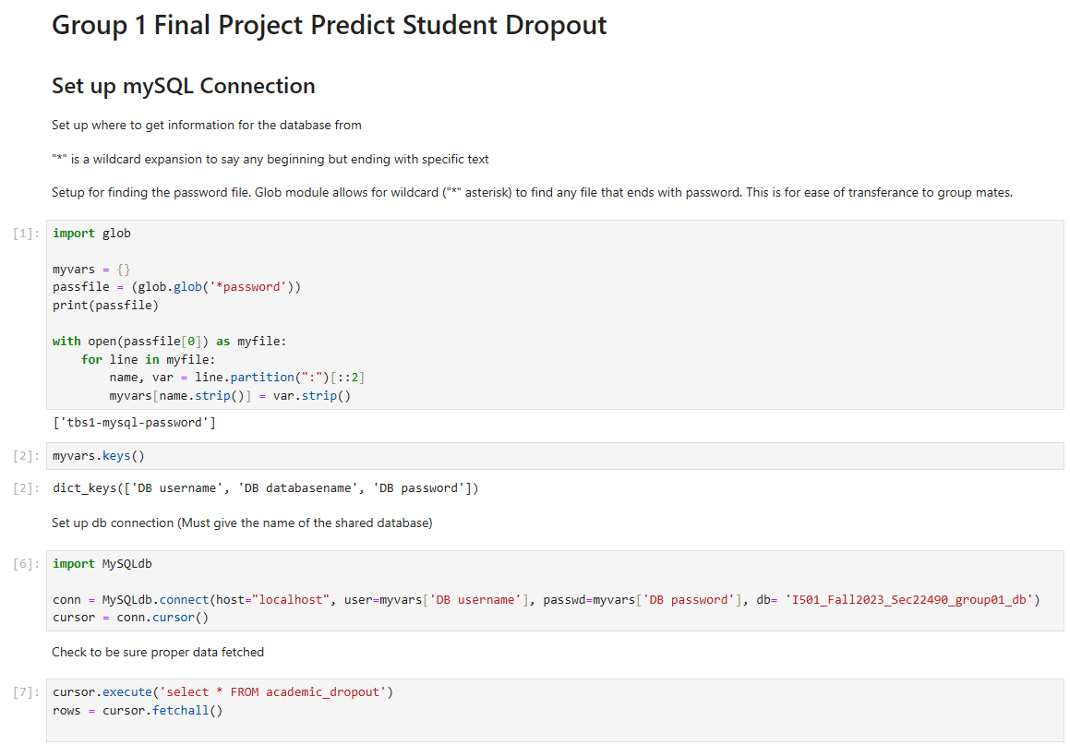
DATA STORAGE
SQL – PYTHON CONNECTION
We used the code in which it uses cursor.execute() to run an SQL query selecting all data from the "academic_dropout" table, and cursor.fetchall() fetches and stores all the retrieved rows from that table in the variable rows.

Slide 9
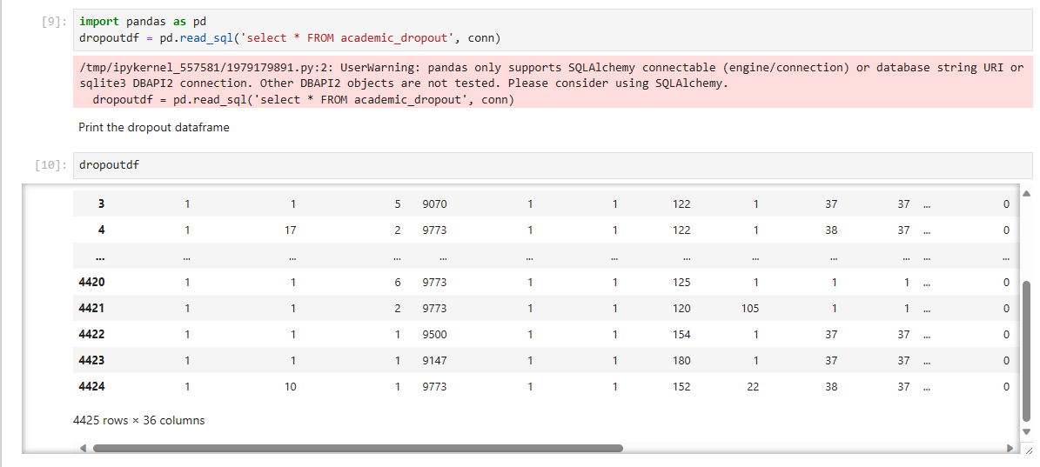
DATA STORAGE
- MAKE DATAFRAME FROM THE TABLE

Slide 10
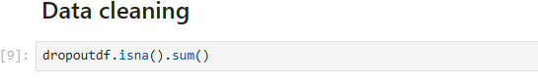
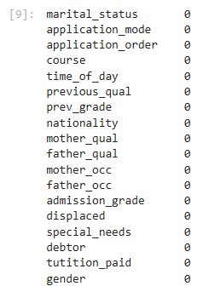
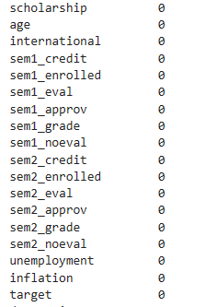
No Column had missing values
Notes:
None column has na

Slide 11
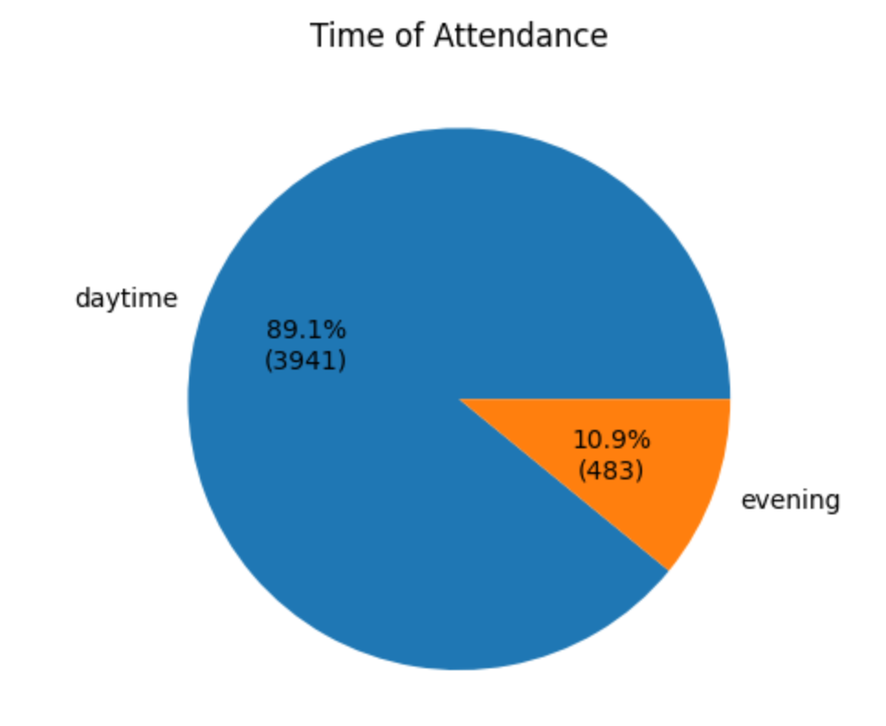
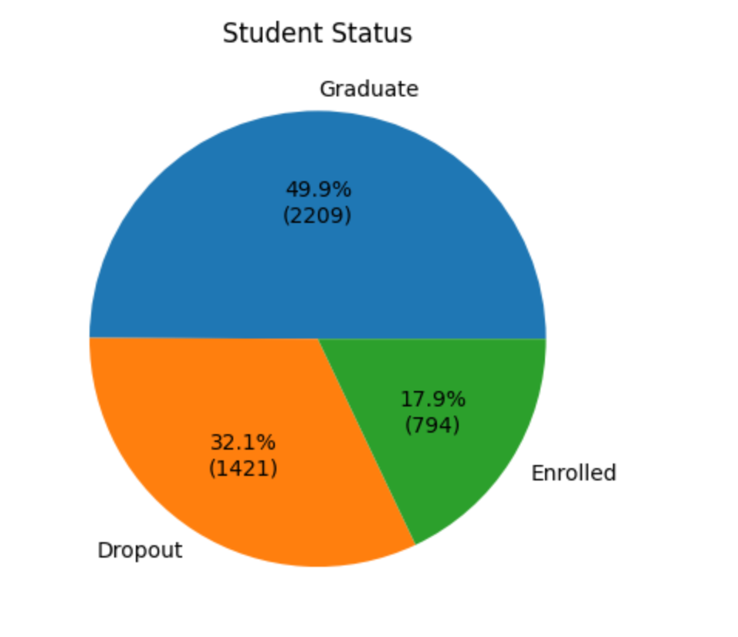
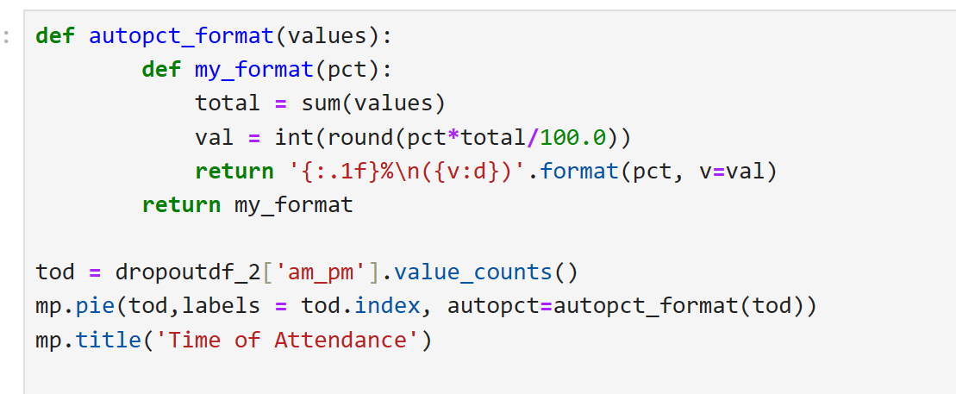
DATA VISUALIZATION
Categorical variables without many categories were visualized using a pie chart
There were more students that attended during the day than in the evening
There were more students as graduate status than in the drop and there were fewest in the enrolled status
Notes:
Summary of the pie charts

Slide 12
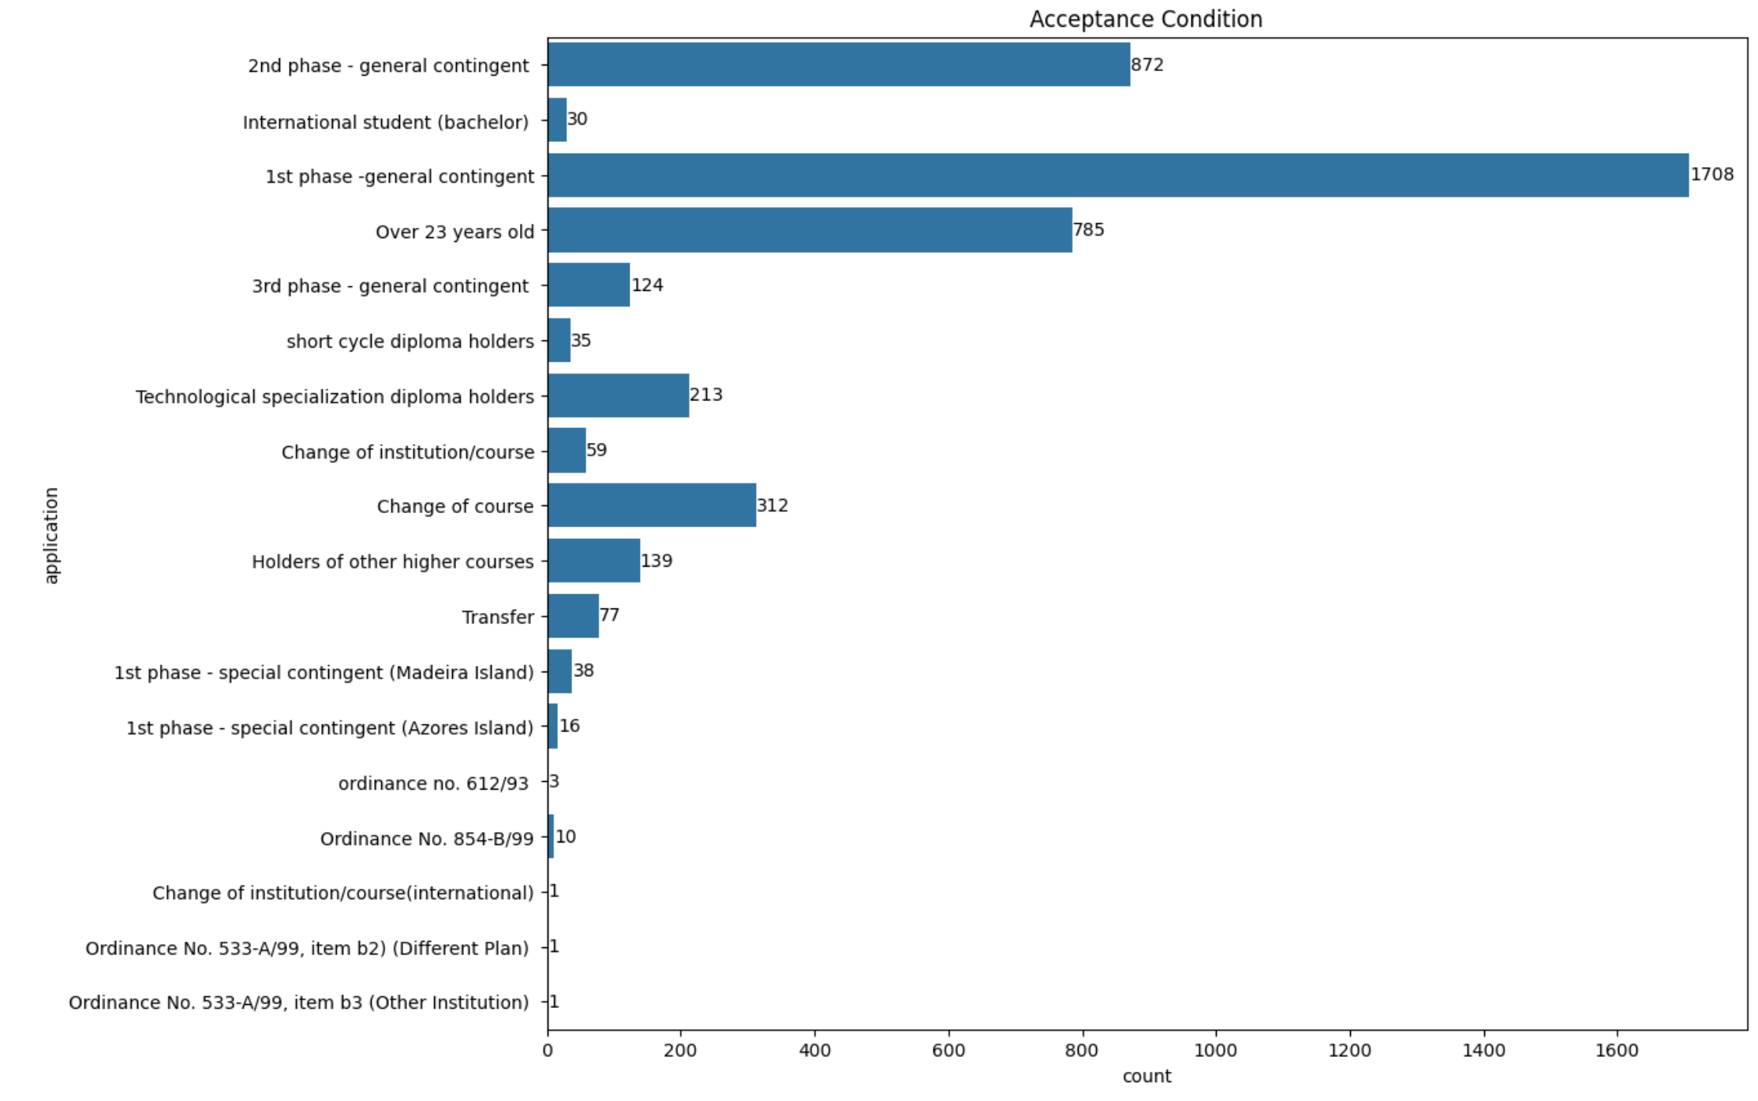
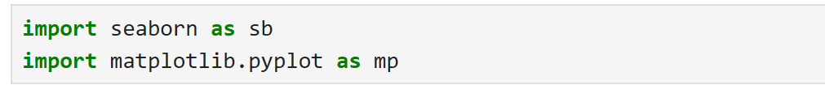
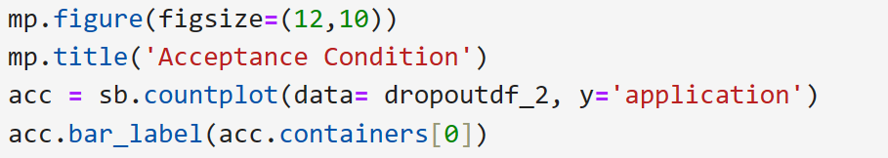
DATA VISUALIZATION
Variables with many categories were visualized using count plot
- Most students accepted in the 1st phase general contingency category
- 2nd Phase – general contingent had the second highest amount of students
- 785 students are over 23 years old
Notes:
inference

Slide 13
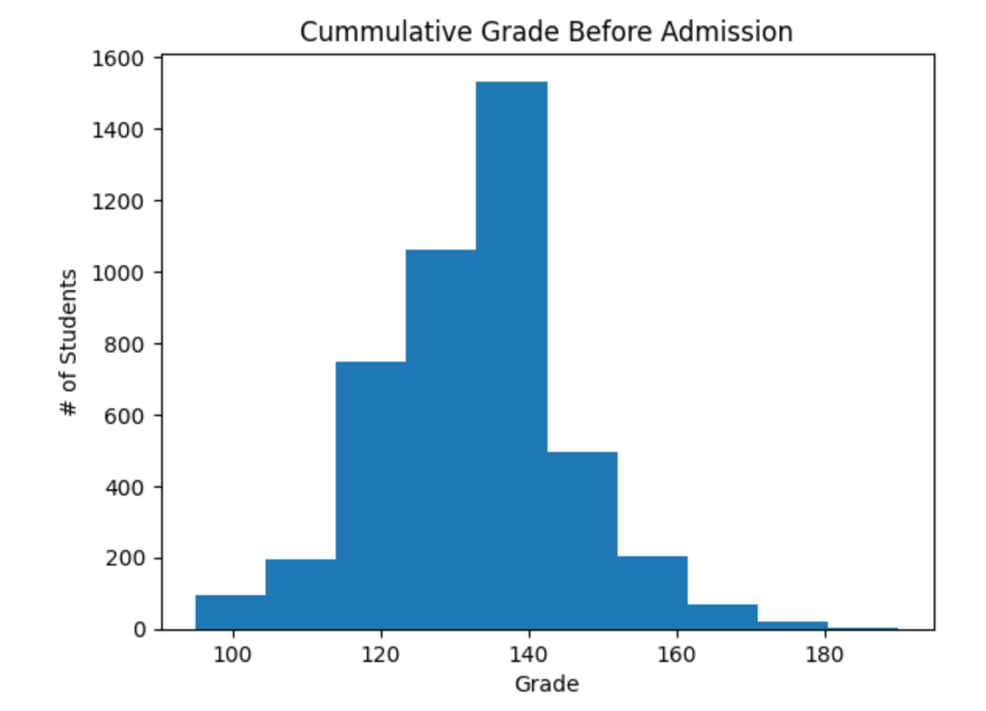
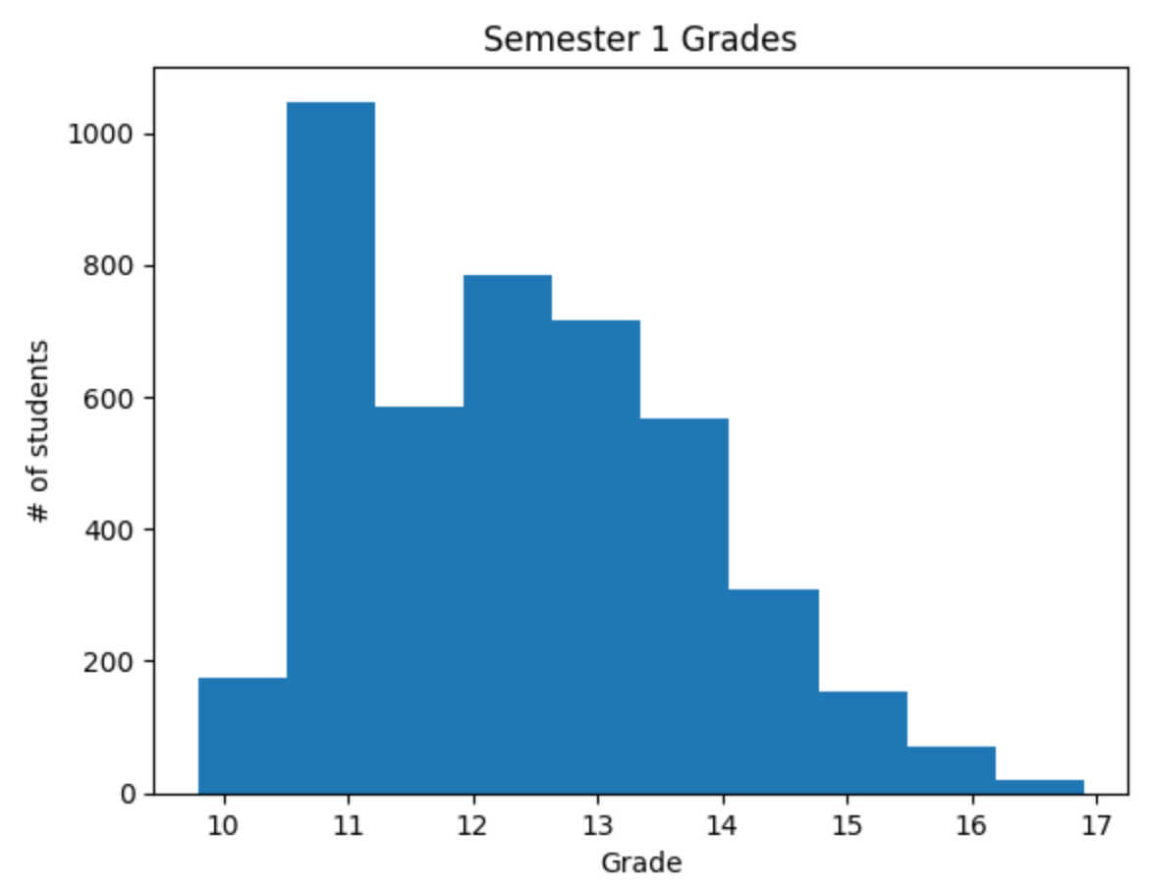
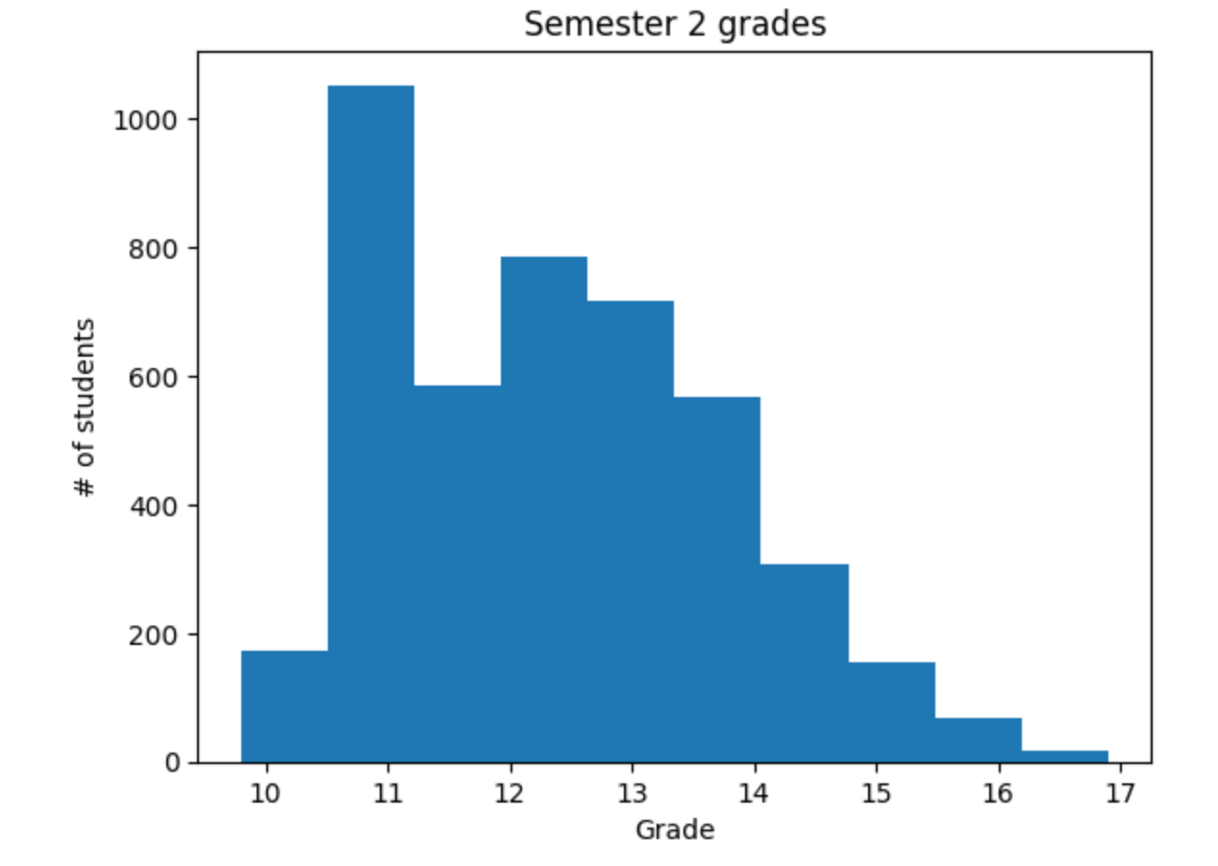
DATA VISUALIZATION
Continuous data visualized using histograms
The cumulative grades before admission are normally distributed
Semester 1 grades are right skewed
Semester 2 grades are right skewed
Notes:
inferences

Slide 14
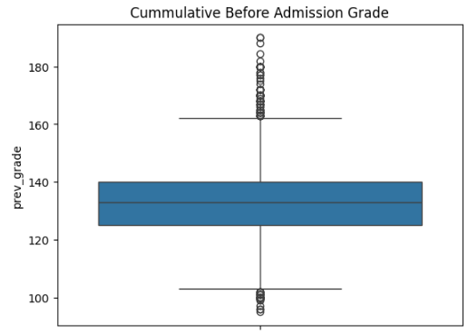
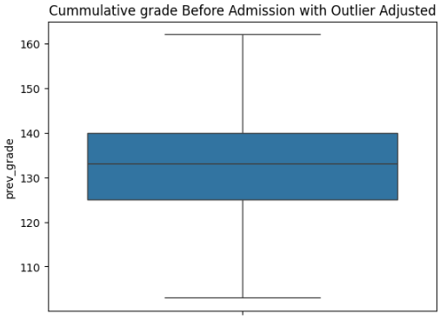
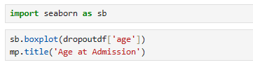
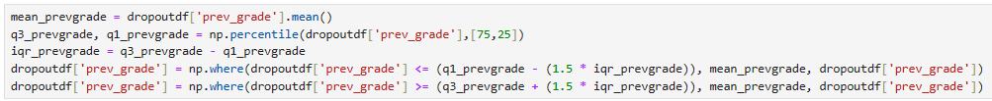
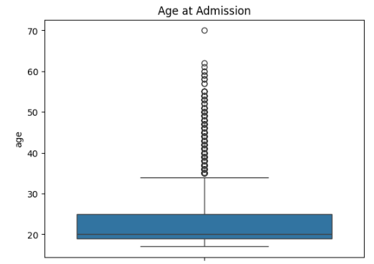
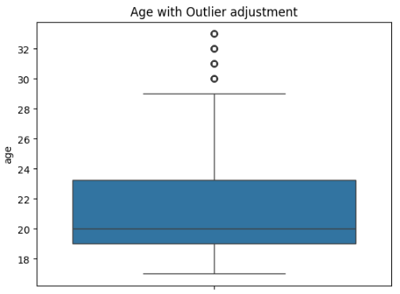
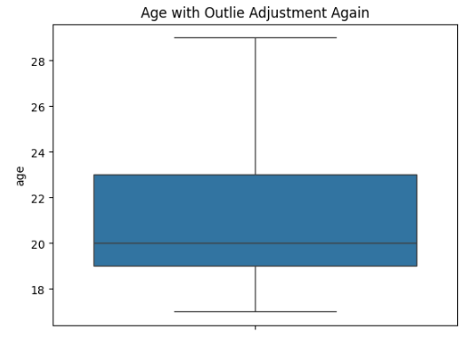
OUTLIERS DETECTION and ADJUSTMENT
Boxplot to identify outliers in continuous data using seaborn module
Cumulative Grade Prior to admission had outliers that required normalization
Outliers converted to Mean
Low outlier = Lower Quartile – 1.5x Interquartile range
High outlier = Upper quartile + 1.5x Interquartile range
Age at Admission has outliers that required two rounds of normalization
Notes:
Put the normal in appendix – Outliers for the 3

Slide 15
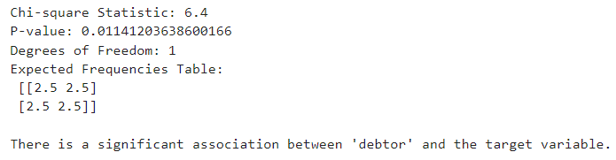
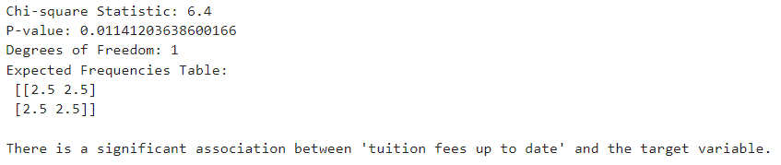
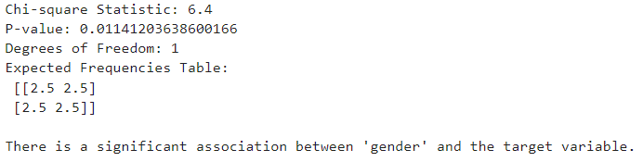
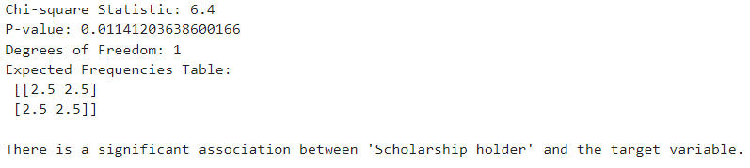




STATISTICAL TESTING:
We performed statistical tests based on the nature of variables, as in Chi-square test, and Mann-Whitney test to find the statistical significance.
Chi-square tests indicate that there is a significant association between debtor, tuition fees up to date, gender, and scholarship holder and the target.
Hypotheses
NULL: There are no difference in proportion target category and variable
Alternative: There is a difference in proportion target category and variable
Notes:
Move to appendix

Slide 16
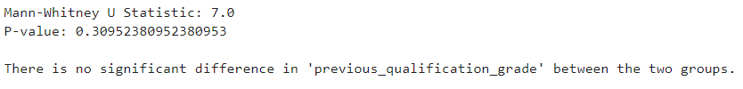
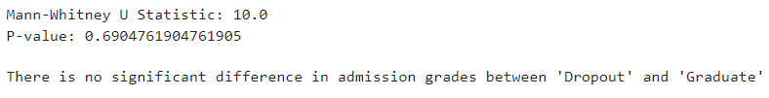


Mann-Whitney Tests:
Hypotheses
Null : There are no difference in the means of the groups
Alternative: There is a difference between the means of the groups
Mann-Whitney test indicates that there is no significant association between previous qualification grade, admission rates and the dropout rate.
Notes:
NULL and alternative hypotheses

Slide 17
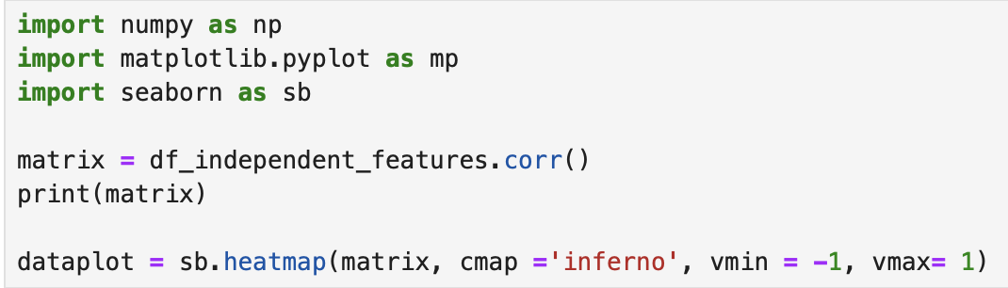
Correlation Matrix
Correlation Matrix Formation for Independent Variables
Correlation matrix for independent variables which depicts the correlation between all pairs of independent variables.
A correlation matrix displays correlation coefficients between variables, indicating the strength and direction of their relationships. Ranging from -1 to 1, a coefficient of 1 signifies a perfect positive correlation, -1 a perfect negative correlation, and 0 no correlation.
Correlation matrices are valuable tools for understanding complex datasets and guiding statistical analyses.
Notes:
Just show code snippelt for feature engineering
Why feature selection

Slide 18
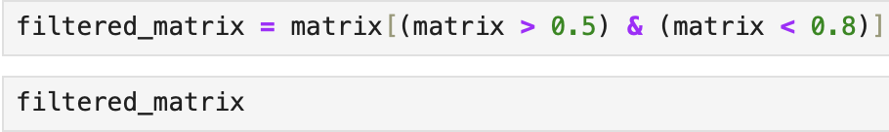
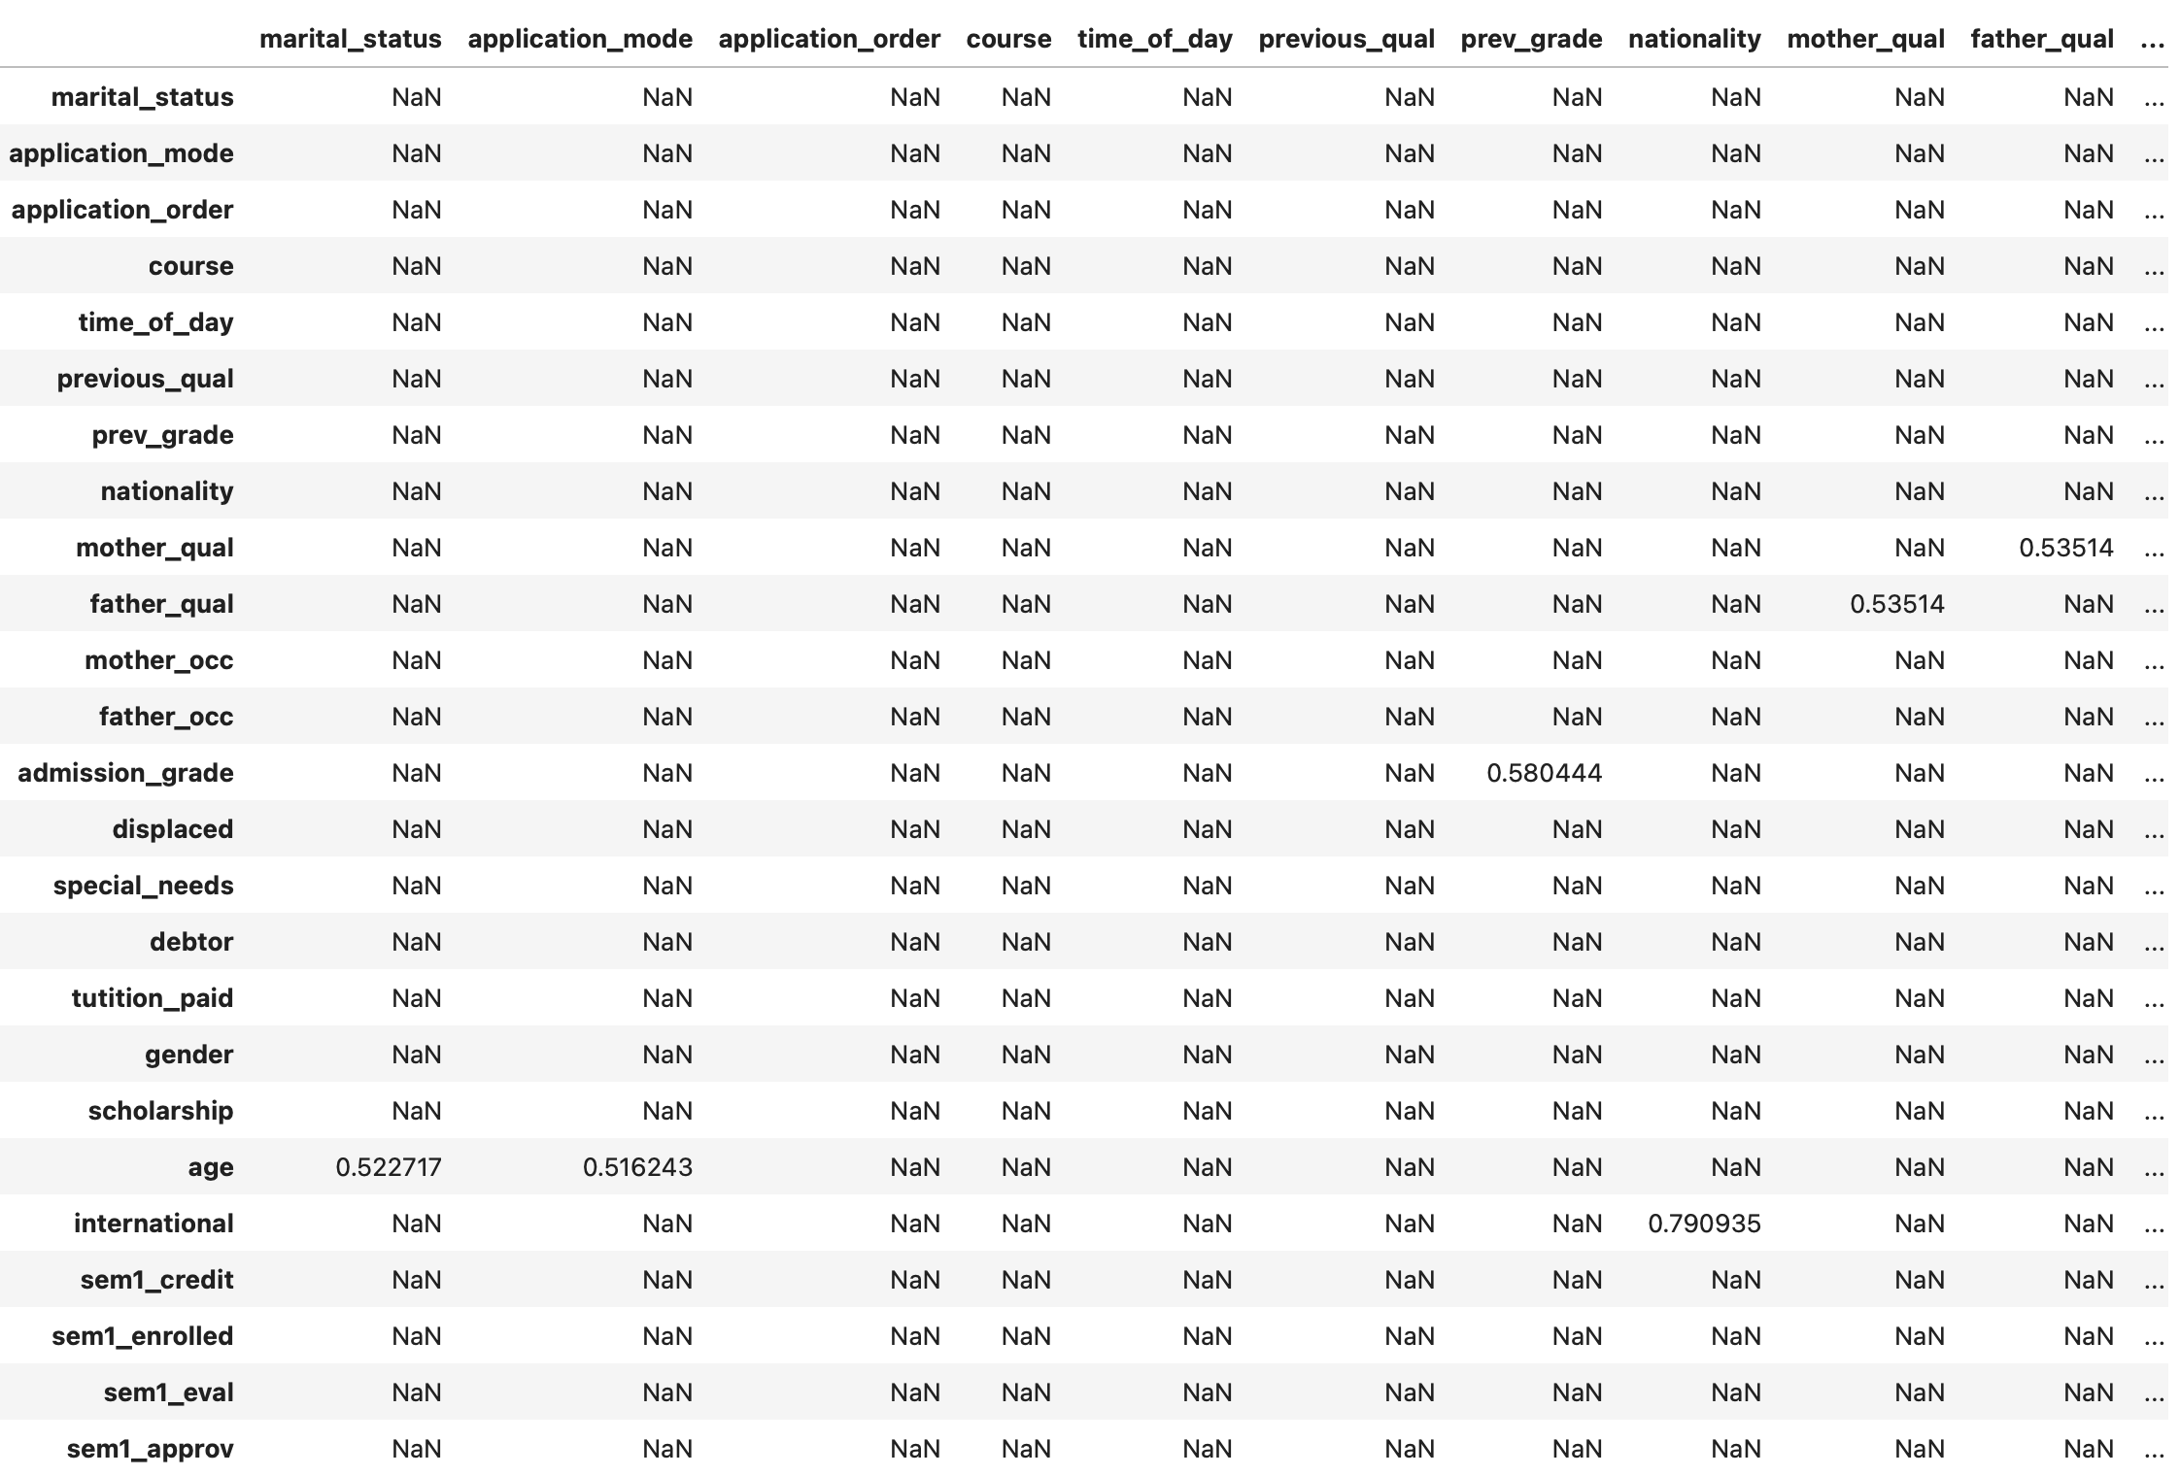
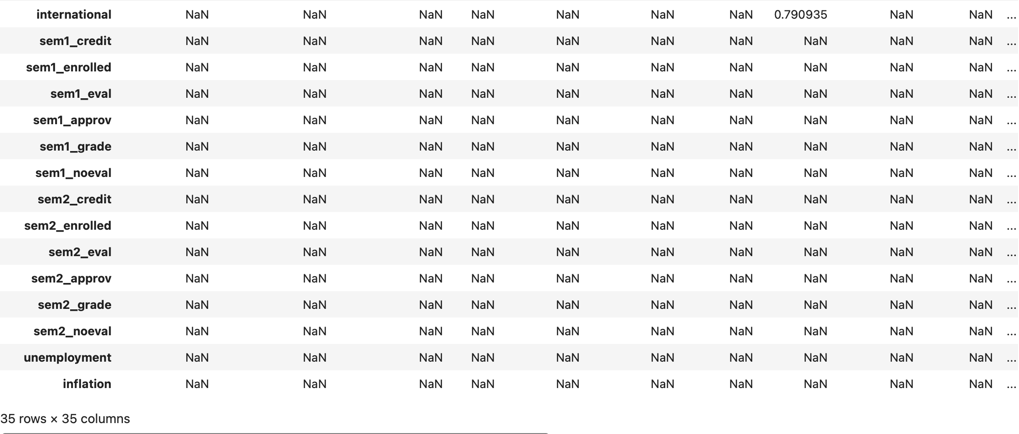
Filtering Correlation Matrix
keeping only those pairs of independent variables which have the correlation within the range [0.5, 0.8]

Slide 19
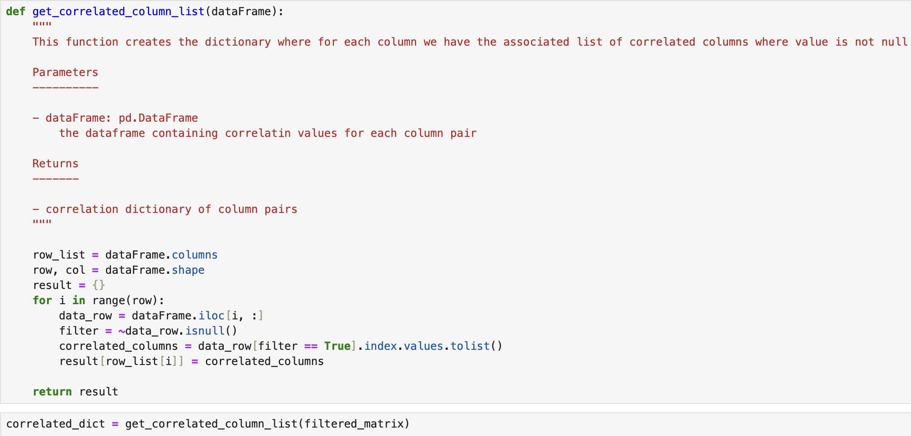
As we can see in the filtered correlation matrix that for each column, we have some associated columns which satisfies our filtering criteria and have non-null correlation values. Next step, is to pick the column pairs from this filtered correlation matrix which have non-null correlation between them. Therefore, we want to have the column pairs which satisfies the filtering criteria i.e. 0.5 <= correlation <=0.8
Notes:
Not feature engineering state. Here state the filter or matrix

Slide 20
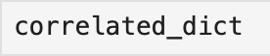
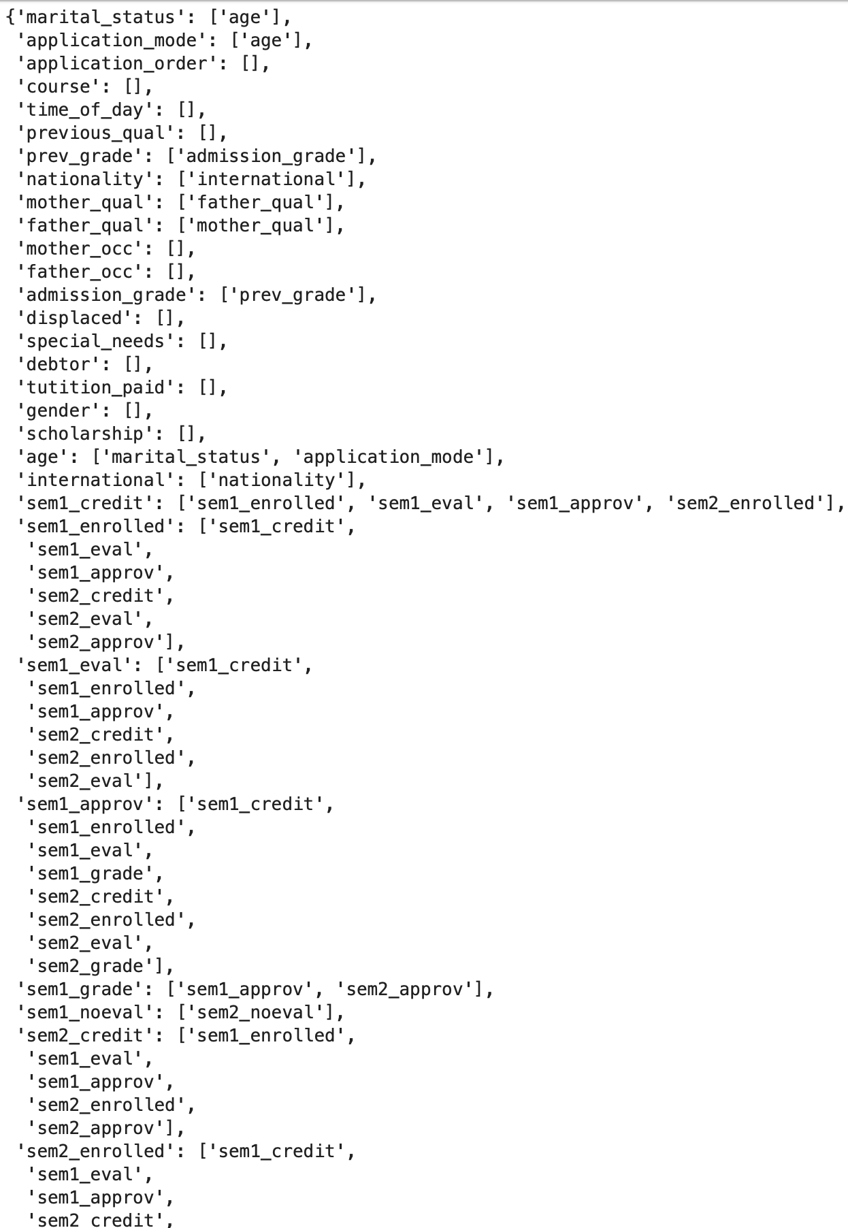
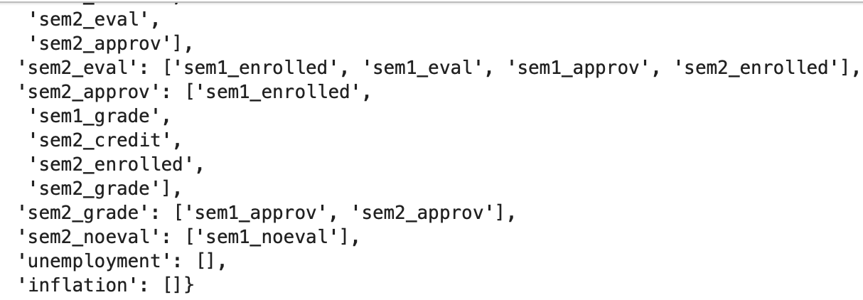
We can see in our correlation dictionary below that each column has a respective list of columns where the correlation condition was satisfied from filtered correlation matrix. Moreover, one can see some instances where for some columns we have empty list which shows that for these columns no other column was present which satisfied the above defined correlation condition. Therefore, such columns could be ignored for further processing down this notebook.

Slide 21
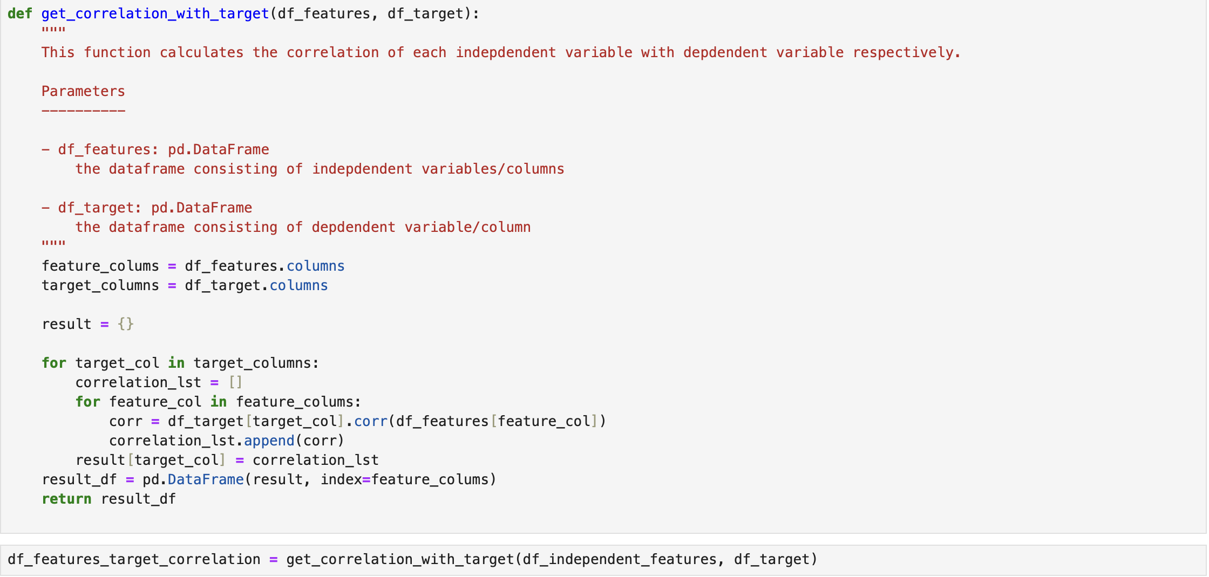
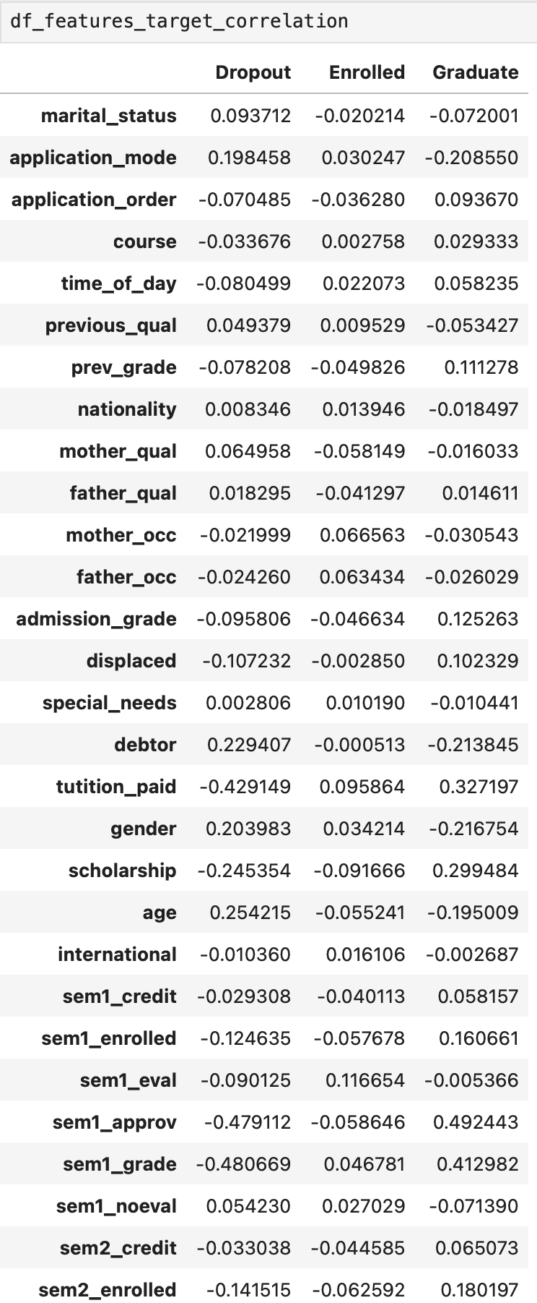
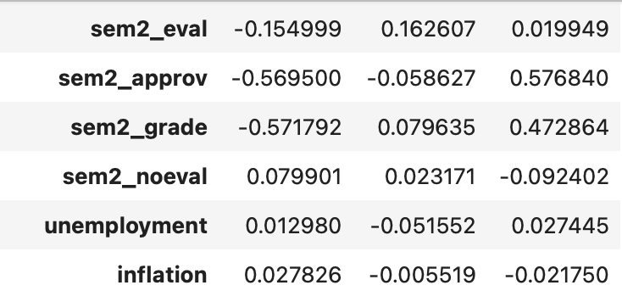
Calculating Correlation of Independent Variables with Target Variables
Here we can see that the above defined function gives us a dataframe which consists of correlation for each independent variable for three target classes.

Slide 22
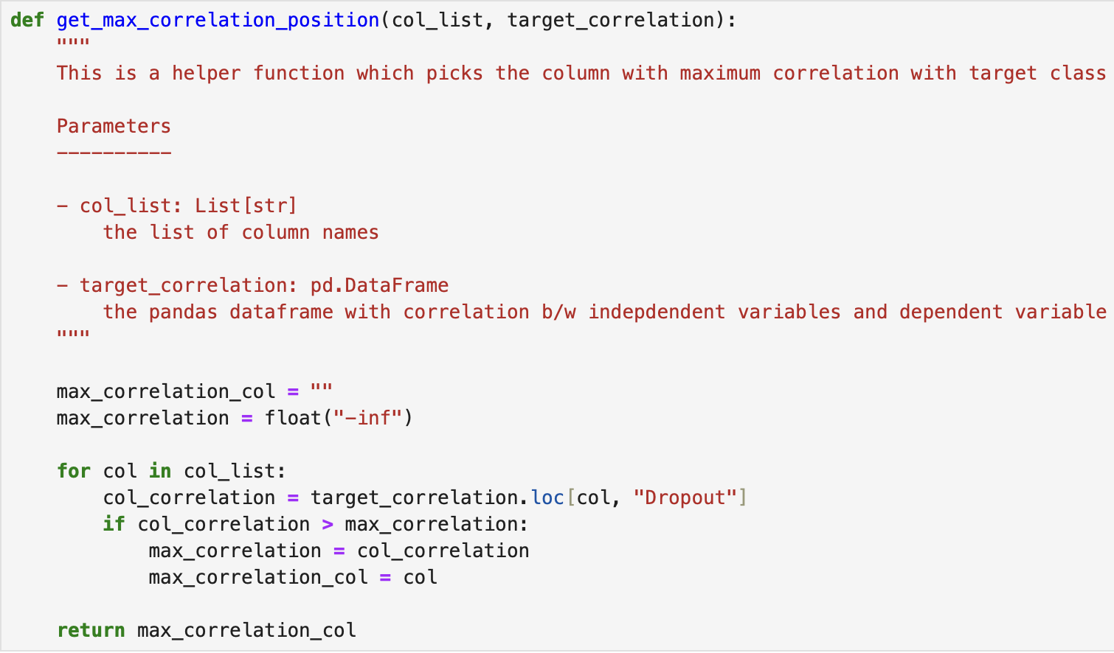
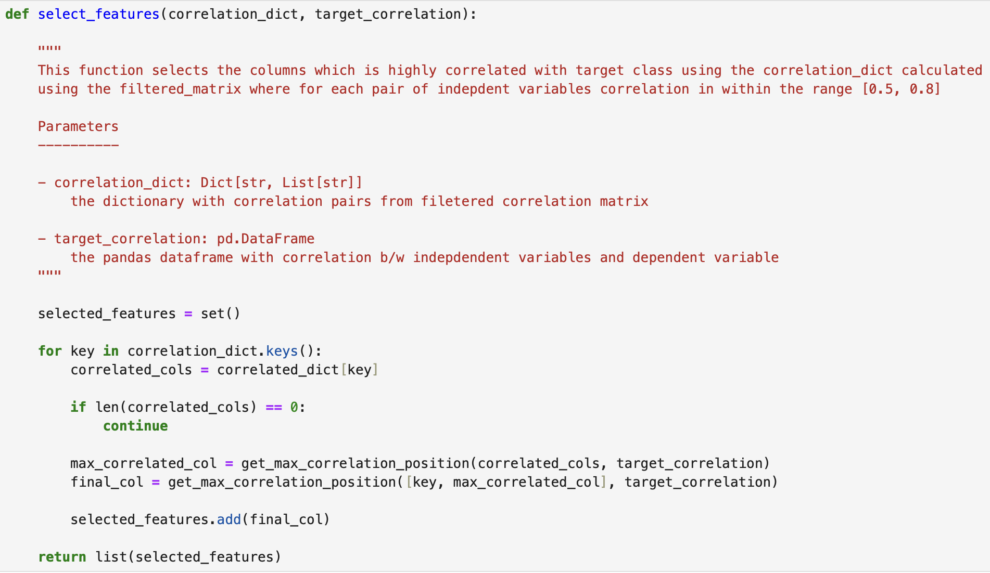
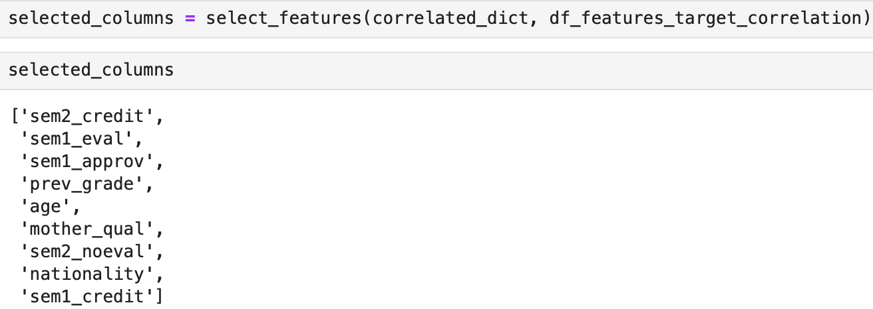
Selecting Independent Variables that are Highly Correlated with Dependent Variable
Using the above defined functions we find out the unique independent variables from highly correlated independent variable pairs which have maximum correlation with dependent variable i.e. Dropout class.
Notes:
Highlight target variables

Slide 23
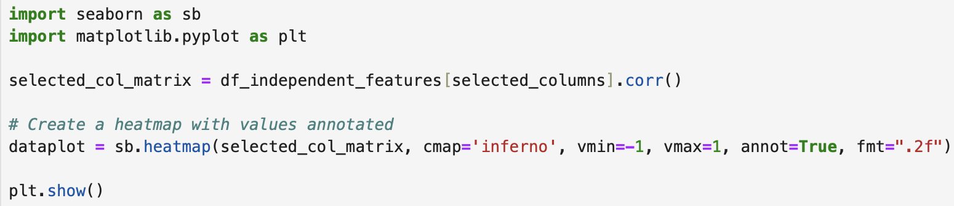
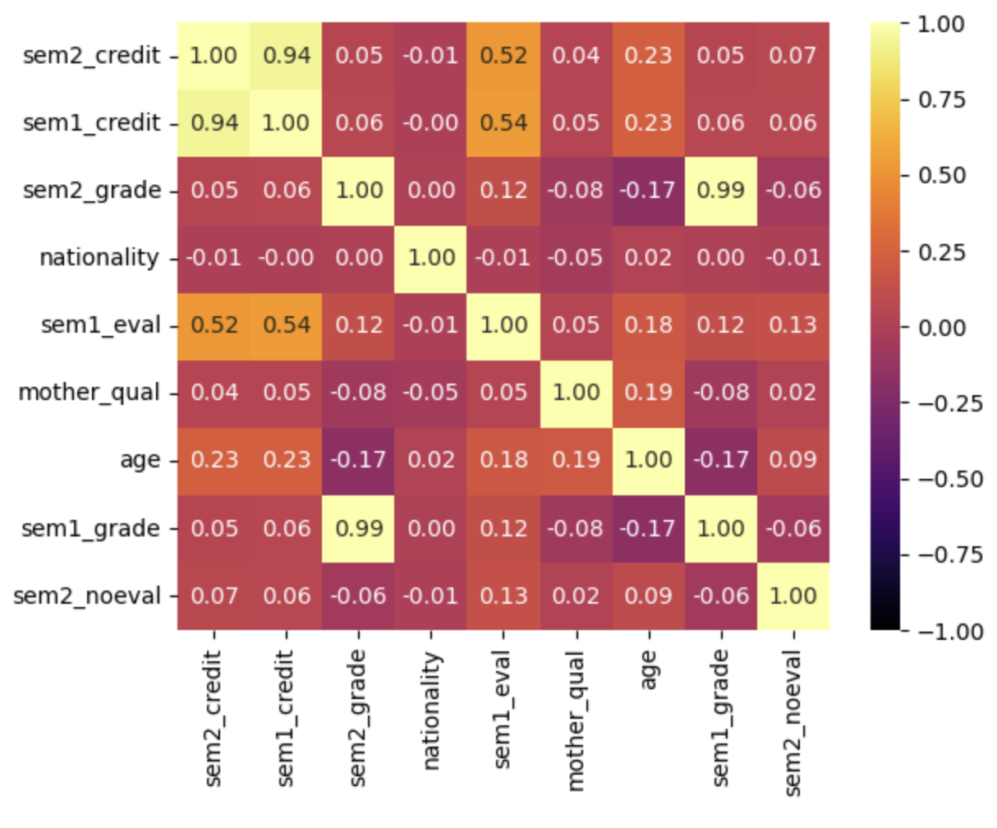
Correlation Matrix –
Heatmap of selected independent variables
A heat map is a data visualization technique that represents the magnitude of a phenomenon as colors in a matrix.
It frequently uses color intensity to show the strength of correlations between variables in the context of correlation matrices or multivariate data. Cooler hues, like blue, indicate lower values, whereas warmer hues, like red, signify higher values. Heat maps are used for their ability to quickly convey complex information, making patterns and trends in large datasets more accessible.
Notes:
/why corr matrix?

Slide 24

MACHINE LEARNING MODELS
LOGISTIC REGRESSION
RANDOM FOREST
DECISION TREE

Slide 25
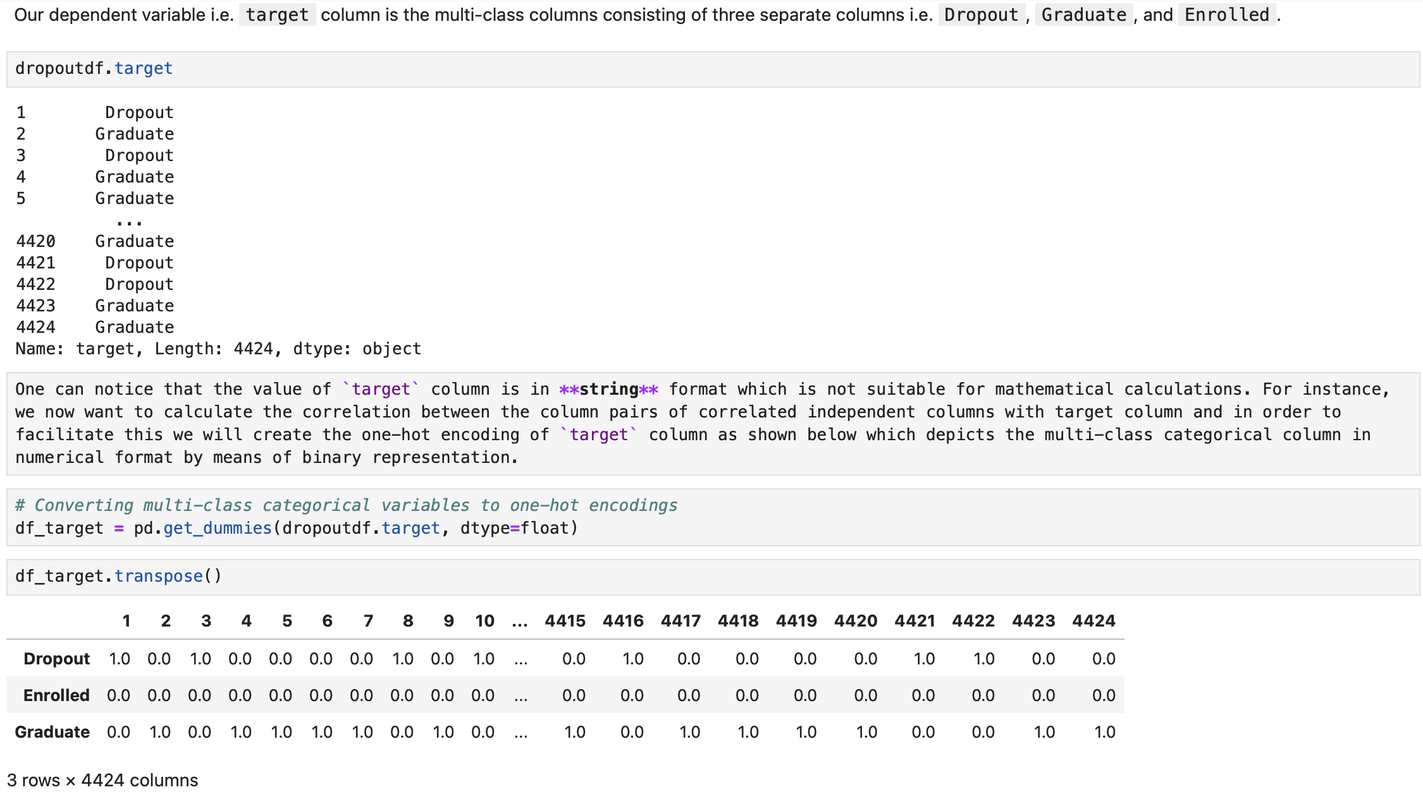
Creating One Hot Encoding for Categorical Target Variable
Notes:
More legible

Slide 26
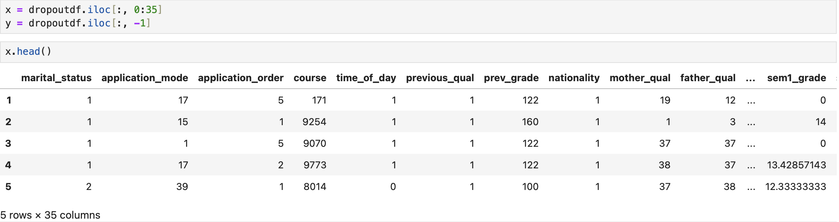

Splitting and Training Dataset
Splitting data in machine learning involves dividing a dataset into training and testing sets. The training set is used to teach the model patterns, and the testing set evaluates the model's ability to make accurate predictions on new, unseen data. This helps assess the model's performance and generalization.
we separate out the independent and dependent variables in two different dataframes.
Splitting dataset into training and test set
Notes:
What is the split and why?

Slide 27

Feature Selection
Feature selection is done in machine learning to improve model efficiency and accuracy by choosing the most relevant and impactful features. It helps reduce complexity, prevent overfitting, and enhances the model's ability to generalize well to new, unseen data, resulting in better overall performance and interpretability.
Checking shape of data and potential null values in each columns
In our dataset comprising 35 features, we performed feature selection to retain the most relevant ones that significantly contribute to predicting the target variable, "Dropout Rate." This process aims to enhance model efficiency, reduce complexity, and ensure that the selected features are key contributors to accurate predictions.
We can see, there are no null values present in any columns.
Notes:
Why feature selection and why for our data

Slide 28


Feature Engineering
Feature engineering is enhancing a machine learning model's performance by selecting, transforming, or creating features in a dataset. It involves optimizing variables for improved model accuracy and efficiency, often leveraging domain knowledge to make the input more meaningful for better predictions.
Forward feature selection is a method in machine learning where you start with no features and add them one by one, choosing the one that improves model performance the most. It helps find the most important features for accurate predictions while minimizing complexity.
Using forward feature selection with Random Forest Classifier to select statistically significant important features from whole feature space which could significantly improve the overall performance of classifier in predicting the dropout cases.
There are total 17 important features out of 35 available features which are statistically important in predicting the target class.
Notes:
Make Feature engineering heading
What is forward feature selection?

Slide 29

Determining Proportion of each class in the dataset
The dataset contain imbalances
Non-dropout - 67.9%
Dropout - 32.1%

Slide 30



SMOTE
SMOTE, stands for Synthetic Minority Over-sampling Technique, is a technique used in machine learning to address the class imbalance problem, particularly in binary classification tasks.
Class imbalance occurs when one class in the dataset has significantly fewer instances than the other class.
SMOTE works by generating synthetic samples for the minority class, thereby balancing the class distribution. It does this by creating synthetic instances along the line segments joining existing minority

Slide 31

Logistic Regression
Logistic regression is used for binary classification.
It is a type of regression analysis that is suited for predicting the probability of an outcome that can take one of two possible values, such as 0 or 1, true or false, yes or no.
0-Non dropout
1-Dropout
Notes:
Give a short introduction of the model

Slide 32





Logistic Regression
Results:
Sensitivity: 87.52%
Specificity: 77.84%
Accuracy: 84.06%
Training score: 84.48%
Testing Score: 84.06 %
The accuracy scores on both the training and testing sets are consistent.

Slide 33



CONFUSION MATRIX – LOGISTIC REGRESSION
Confusion Matrix provides details about the number of true positive (498), true negative (246), false positive (70), and false negative (71) predictions
Notes:
One line of explanation

Slide 34

DECISION TREE
A decision tree is a versatile and interpretable machine learning algorithm used for both classification and regression tasks.
It recursively splits the dataset into subsets based on the most significant attribute at each node, forming a tree-like structure.
The decision tree makes decisions by traversing from the root to the leaves based on the features of the input data.

Slide 35





DECISION TREE
Results:
Accuracy: 82.6%
Training: 84.4%
Testing: 84.1%
Sensitivity: 88.4%
Specificity:72.2%
Sensitivity and specificity accuracy percentages shows relatively high sensitivity for "non_dropout" instances but slightly lower specificity for "Dropout" instances.

Slide 36



CONFUSION MATRIX – DECISION TREE
Classification report indicates that the decision tree model, trained on the resampled data, performs reasonably well in distinguishing between "Dropout" and "non_dropout" classes. The model shows a good balance between precision and recall, with a reasonably high accuracy score.
Notes:
inference

Slide 37

RANDOM FOREST
Random Forest operates by constructing a multitude of decision trees during training and outputs the class that is the mode of the classes (classification) or mean prediction (regression) of the individual trees. It builds on the decision tree algorithm and introduces randomness to improve the model's performance and generalization.

Slide 38



RANDOM FOREST PERFORMANCE
Results:
Accuracy: 84.9%
Training: 95.6%
Testing: 84.9%
Sensitivity: 89.9%
Specificity:75.6%
Sensitivity and specificity metrics give insights into how well the model performs on positive and negative instances, respectively. The model's performance on the training set and testing set performance is good.

Slide 39



CONFUSION MATRIX – RANDOM FOREST
The model shows good accuracy, precision, recall, and F1-score values for both classes.
Notes:
inference

Slide 40



The ROC curve visually represents a binary classifier's trade-off between true positive and false positive rates across different decision thresholds. A higher Area Under the Curve (AUC-ROC) indicates superior model discrimination. The ROC Curve analyzing our three machine learning models indicates that Logistic regression (AUC of 0.89) and Random forest (AUC of 0.89) have highest accuracy and the least for Decision Tree (AUC of 0.78).
ROC CURVE
Notes:
GREAT!

Slide 41
RESULTS -Hypothesis Determination and Model accuracy:
We Accept the Alternative Hypothesis that we were able to predict student dropout with predictors.
Logistic Regression and Random Forest models demonstrate the highest accuracy, both achieving an AUC of 0.89.
Decision Tree, while slightly less accurate, still exhibits a respectable AUC of 0.78.
These findings emphasize the significance of predictive modeling in understanding and addressing factors influencing student dropout.
The outcomes provide educational institutions with a proactive approach to enhance student retention.

Slide 42

Limitations
GDP variable not able to be included for analysis
Outliers in dataset for some variables
The generalization of this model has not been determined on another dataset
There may be unobserved variables contributing to the difference such as mental health status

Slide 43
Appendix

Slide 44


Outlier Detection
No Outliers in inflation and unemployment rate date

Slide 45




OUTLIERS ADJUSTMENT
Semester 1 and Semester 2 grades had outliers that were normalization to the mean values

Slide 46



OUTLIERS 2 ROUNDS OF REMOVAL
Grade at admission required two rounds of normalization to reduce outliers

Slide 47











STATISTICAL TESTING:
We performed statistical tests based on the nature of variables, as in Chi-square test, and Mann-Whitney test to find the statistical significance.
Hypotheses
NULL: There are no difference in proportion target category and variable
Alternative: There is a difference in proportion target category and variable
The Chi-square test reveals that there is no statistical association between marital status, application mode, application order, course, and time of the day with the target i.e., dropout or not.

